Slide 2
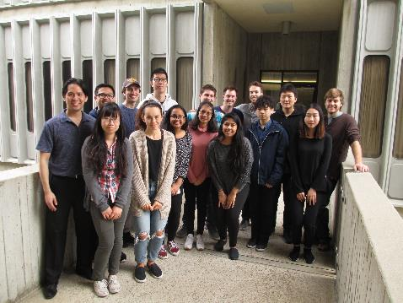

Breaking the Law of Practice Tim Rickard

Slide 3
Principles and Process Models
(selective review)
Candidate Empirical Laws of Practice

Slide 4
Principles and Process Models
(selective review)
Candidate Empirical Laws of Practice
Newell and Rosenbloom (1981):
The Power Law

Slide 5
The Power Law of Practice
Newell & Rosenbloom, 1981
RT = a + bN ^{-c}
Where RT is expected value.
RT = 500 + 4000N ^{-.8}

Slide 6
Principles and Process Theories
(selective review)
Candidate Empirical Laws of Practice
Newell and Rosenbloom (1981):
The Power Law
Logan (1988): Instance Theory of
Automatization

Slide 7
Some Tasks that exhibit process shifts.
various arithmetic-like tasks
e.g., alphabet arithmetic: h + 5 = ?
numerosity judgement
answer Look-up
mental rotation
etc.

Slide 8
The Instance Theory of Automaticity
Gordon Logan, 1988, Psych. Rev.
On each algorithm and retrieval trial, a new memory “instance” is formed which can
compete independently and in parallel (i.e. in a “horserace”) with the algorithm and other
memory instances on subsequent trials.
Memory instance retrieval latencies are iid.
Prediction derived from the statistics of extremes: Practice yields a transition to
memory-based performance and RT improvement must follow the power law.

Slide 9
Principles and Process Theories
(selective review)
Candidate Empirical Laws of Practice
Newell and Rosenbloom (1981):
The Power Law
Logan (1988): Instance Theory of
Automatization

Slide 10
Principles and Process Theories
(selective review)
Candidate Empirical Laws of Practice
Newell and Rosenbloom (1981):
The Power Law
Logan (1988): Instance Theory of
Automatization
Rickard (1997): The Process Shift Theory
The process shift function

Slide 11
The Process Shift Theory
Rickard , 1997, JEP:General
RT improvement within any given process follows the power function.
Whenever the process that governs performance on an item is non-optimal, there is a probabilistic shift over subsequent practice trials to a faster process.
There is a structural cognitive bottleneck such that at an given moment during a trial, only one process can be executed.
The shift model as originally developed adds two more constraints for simplification:
Immediately after cue encoding on each trial, a choice process determines which process will be executed. Once a process has been chosen, it runs ballistically to the exclusion of other candidate processes and determines RT and accuracy.
The process choice has zero latency.

Slide 12
The Process Shift Theory
Rickard , 1997, JEP:General
Full quantitative implementation for item-level practice curve:
If process = algorithm:
If process = retrieval:
RT_{alg} = a₁ + b₁N ^{–c1}
RT_{ret} = a₂ + b₂N ^{–c2}
RT_{alg} > RT_{ret} for all N.

Slide 13
The Process Shift Theory
Rickard , 1997, JEP:General
In practice, the asymptote parameters explain minimal variance,
so can be ignored in data fitting.
If process = algorithm:
If process = retrieval:
RT_{alg} = a₁ + b₁N ^{–c1}
RT_{ret} = a₂ + b₂N ^{–c2}
RT_{alg} > RT_{ret} for all N.

Slide 14
The Process Shift Theory
Rickard , 1997, JEP:General
In practice, the asymptote parameters explain minimal variance,
so can be ignored in data fitting.
If process = algorithm:
If process = retrieval:
RT_{alg} = b₁N ^{–c1}
RT_{ret} = b₂N ^{–c2}

Slide 15
The Process Shift Theory
Item level prediction
Rickard (1997; 1999) compared the shift model to the power law for data averaged
over items and subjects.

Slide 16
Principles and Process Models
(selective review)
Candidate Empirical Laws of Practice
Newell and Rosenbloom (1981):
The Power Law
Logan (1988): Instance Theory of
Automatization
Rickard (1997): The process shift model
The process shift function
Heathcote et al. (2000): The Exponential law

Slide 17
The Power Law Repealed
Heathcote et al., 2000, PB&R
Power: RT = a + bN^{-c}
Exponential: RT = a + be^{-cN}
Slight advantage for the exponential function for fits to subject level means (averaging over items).
Process shift function not included in comparisons.
☹

Slide 18
Principles and Process Models
(selective review)
Candidate Empirical Laws of Practice
Newell and Rosenbloom (1981):
The Power Law
Logan (1988): Instance Theory of
Automatization
Rickard (1997): The process shift model
The process shift function
Heathcote et al. (2000): The Exponential law
Rickard (2004): Item level shift theory fits
The process shift function

Slide 19
An item-level Test of Candidate Models
Rickard, 2004, JEP:LMC
alphabet arithmetic task with algorithm pre-practice
So, instead of this shift function:

Slide 20
An item-level Test of Candidate Models
Rickard, 2004, JEP:LMC
alphabet arithmetic task with algorithm pre-practice
This shift function:
RT_{alg} = µ
RT_{ret} = bN ^{–c}

Slide 21
Item level Fits of the Shift Theory

Slide 22
Item level Fits of the Shift Theory

Slide 23
Item level Fits of the Shift Theory

Slide 24
Principles and Process Models
(selective review)
Candidate Empirical Laws of Practice
Newell and Rosenbloom (1981):
The Power Law
Logan (1988): Instance Theory of
Automatization
Rickard (1997): The process shift model
The process shift function
Heathcote et al. (2000): The Exponential law
Rickard (2004): Item level shift model fits
The process shift function
Bajic and Rickard (2009): Strong Evidence
for the process choice assumption in
the shift model

Slide 25
Stronger Tests of the Choice Process in the Shift Theory
Bajic & Rickard, 2009, JEP:LMC
Tap-count task
A unique two-digit number was presented as the cue for each item.
The algorithm involved silently counting forward by one’s while tapping the space key
on each silent count.
After a preset number of tap-counts that was consistent over trials for each item,
text appears instructing the subject to type the arrived at number as the correct response for that item (i.e., for the presented number cue). Correct answer feedback was then provided. Hence both the number of executed algorithm steps and latencies can be recorded on each trial.
Three types trials could be identified:
algorithm trials
partial algorithm trials
retrieval trials
(2.5%)

Slide 26
Algorithm trials approaching the first correct retrieval exhibit progressive slowing for the first step only.

Slide 27
Principles and Process Models
(selective review)
Candidate Empirical Laws of Practice
Newell and Rosenbloom (1981):
The Power Law
Logan (1988): Instance Theory of
Automatization
Rickard (1997): The process shift model
The process shift function
Heathcote et al. (2000): The Exponential law
Rickard (2004): Item level shift model fits
The process shift function
Bajic and Rickard (2009): Strong Evidence
for the process choice assumption in
the shift model
Heathcote et al. (2018): The Delayed
Exponential law

Slide 28
Refining the Law of Practice
Heathcote et al., 2018, Psych. Rev.
power function:
exponential function:
RT = a + bN ^{-c}
RT = a + be^{-cN}
delayed-power
function:
delayed-exponential
function:
RT = a + b[(τ +1)/(τ + N ^{c})]
RT = a + b[(τ +1)/(τ + e ^{cN})]
Once again Heathcote and colleagues didn’t
include fits of the process shift function.

Slide 29
The Exponential Delay Function
RT = a + b[(τ +1)/(τ + e ^{cN})]

Slide 30
The Exponential Delay Function
RT = a + b[(τ +1)/(τ + e ^{cN})]

Slide 31
The Exponential Delay Function
RT = a + b[(τ +1)/(τ + e ^{cN})]

Slide 32
The Exponential Delay Function
RT = a + b[(τ +1)/(τ + e ^{cN})]

Slide 33
The Exponential Delay Function
RT = a + b[(τ +1)/(τ + e ^{cN})]

Slide 34
The Exponential Delay Function
RT = a + b[(τ +1)/(τ + e ^{cN})]

Slide 35
The Exponential Delay Function
RT = a + b[(τ +1)/(τ + e ^{cN})]

Slide 36
The Exponential Delay Function
RT = a + b[(τ +1)/(τ + e ^{cN})]

Slide 37
The Exponential Delay Function
RT = a + b[(τ +1)/(τ + e ^{cN})]
In this special case the models make identical predictions

Slide 38
The Exponential Delay Function
RT = a + b[(τ +1)/(τ + e ^{cN})]
The process shift model cannot mimic any of those curves.

Slide 39
General process shift patterns that cannot be mimicked
by the ex. delay function.
no algorithm reversions
with algorithm reversions

Slide 40
Principles and Process Models
(selective review)
Candidate Empirical Laws of Practice
Newell and Rosenbloom (1981):
The Power Law
Logan (1988): Instance Theory of
Automatization
Rickard (1997): The process shift model
The process shift function
Heathcote et al. (2000): The Exponential law
Rickard (2004): Item level shift model fits
The process shift function
Bajic and Rickard (2009): Strong Evidence
for the process choice assumption in
the shift model
Heathcote et al. (2018): The Delayed
Exponential law
Current Project

Slide 41
The Process Shift Function vs. The Exponential Delay Function
If alg:
RT = µ
RT = a + b[(τ +1)/(τ + N ^{c})]
If ret:
RT = bN ^{–c}
If the strategy on each trial has to be
estimated, then there are four free
parameters
Four free parameters
I compared these functions for the count-tap data, where strategy on each
trial is known. So the shift function fits had only 3 free parameters.
Algorithm reversion trials are automatically included in the estimate of µ.

Slide 42
Details
32 subjects, up to 10 items per subject
subject/items not exhibiting a strategy shift are set aside for this talk.
For the process shift model, partial algorithm trials were classified as retrieval trials, since that process generated the response.

Slide 43
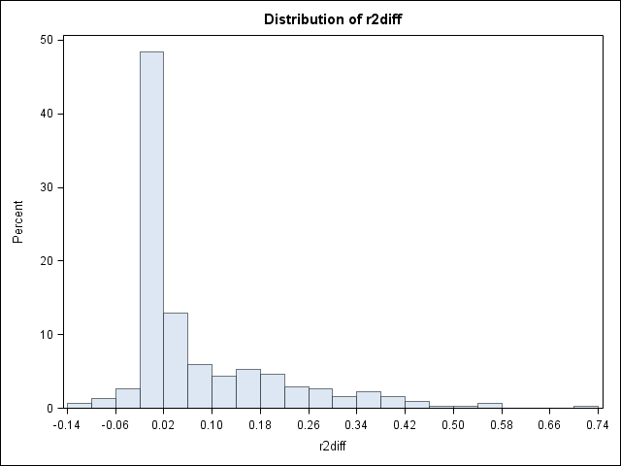
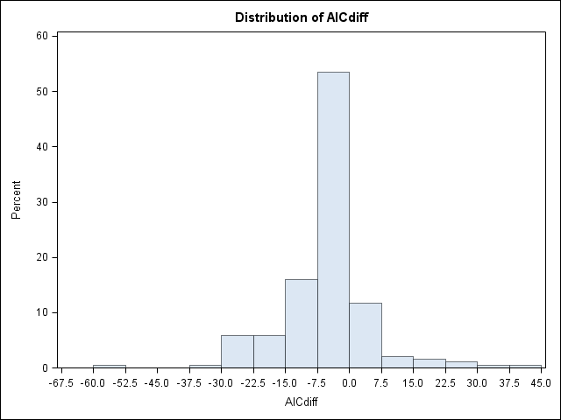
Results
Item level overall (302 items)
R² shift model = .88.88
R² exp. delay model = .80
R² diff = R²-shift - R²-delay
Shift model wins for 233/303 = 77% of items.
p < .0001
Akaike Information Criterion for least squares
(assumes normal residuals):
AIC = 2k + N*nl(RSS)
AIC diff : Shift model wins for 277/303 = 88% of items.
p < .0001

Slide 44
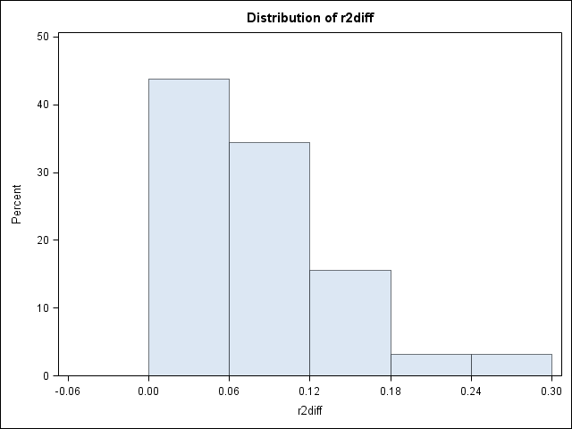
Results by Subject
For both R² and AIC, data from all 32 subjects were better fitted by the shift model

Slide 45
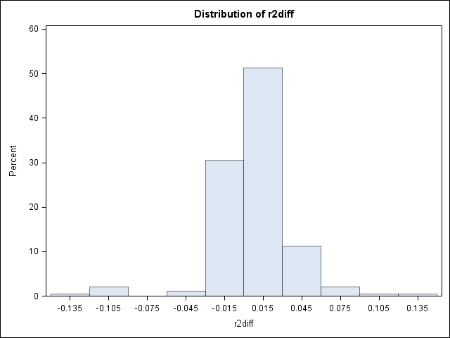
Results for items with no algorithm reversions
R² - shift model = .90
R² - exp delay model = .89
Shift model wins by R² diff: 123/187 = 66%
p < .0001
Shift model wins by AIC: 154/187 = 82%
p < .0001

Slide 47
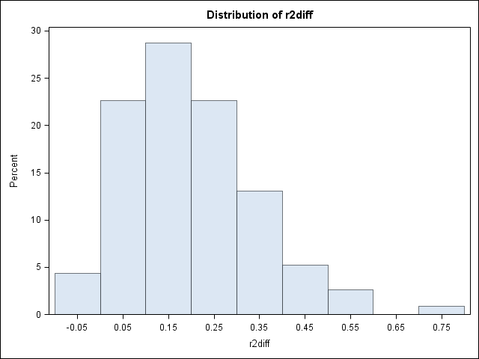
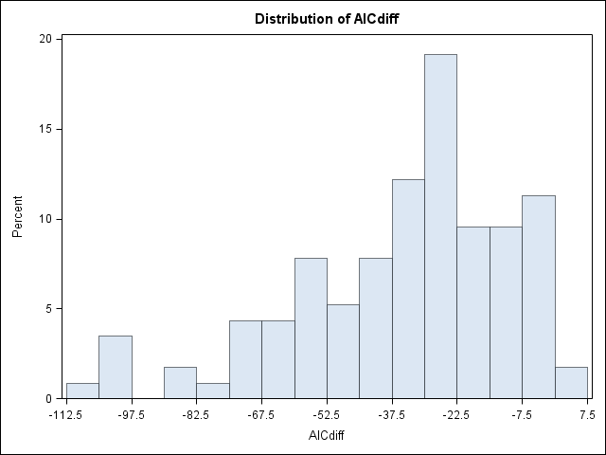
Results for items with algorithm reversions
R² - shift model = .86
R² - exp delay model = .66
Shift model wins by R²: 110/115 = 95%
p < .0001
Shift model wins by AIC: 110/115 = 95%
p < .0001

Slide 49
To Summarize so far, the process shift model wins handily.

Slide 50
Process shift function is a promising candidate
for a generalizable law of practice
Shifts are common and the shift model models them.
Candidate for a scalable law of practice that is applicable to more complex tasks that exhibit multiple shifts.
Within process speed-up is predicted by the model (power function).

Slide 51
Generalization to Other Tasks
Results are expected to generalize to other clear algorithm to retrieval transition tasks:
Various arithmetic
numerosity judgement
answer Look-up
mental rotation
etc.
Also perhaps to tasks for which different, less apparent type of shifts may occur.
e.g., retrieval practice

Slide 52
Generalization to Other Tasks
(retrieval practice)
Rickard and Bajic, 2006, JEP:LMC
Subjects first studied a set of 16 word triplets
under instructions to use interactive imagery.
Care wall crash
Cow grass milk
Spray ants trash
…
…
Next they practiced retrieving one word given
the other two words as cues, 20 times per triplet..
Car crash ???
Finally there was a transfer test that I’ll not discuss here.

Slide 53
Implications for Other shifts Tasks:
e.g., Memory Retrieval Practice
Experiment 1
Experiment 2

Slide 54
Technical Challenge: How to achieve fair and veridical fits of the shift model, including algorithm reversion trials, without foreknowledge of the strategy used on each trial?

Slide 55
Item level Fits of the Shift Theory

Slide 59
Application

